Slide 1




Weather Type Detection Data Science Project
Team members
Saher Muhamed
Omar Ayman
GitHub Repo Link

Slide 2
Project Overview
Project Description:
This project aims to predict the weather using various data science and machine learning techniques. We employed classification, regression, and time series forecasting methods to predict weather temperatures accurately
Project Workflow:
Data Description
Exploratory Data Analysis (EDA)
Outlier handling
Data Preprocessing
Model Selection for classification task
Time Series Analysis
Model Selection for Regression Task
Predict Temperature for a Specific Date using forecasting
Web Application Deployment
Dashboard using Power BI

Slide 3
Project Overview
Introduction:
Weather detection and forecasting plays a crucial role in daily planning and decision-making across various sectors. By leveraging machine learning techniques, this project aims to predict weather conditions based on comprehensive datasets encompassing temperature, humidity, wind speed, precipitation, cloud cover, atmospheric pressure, UV index, season, visibility, and location. Accurate predictions not only enhance preparedness but also optimize resource allocation and risk management in diverse environmental contexts.
Objective:
Objective: Develop a detection model to predict weather conditions (e.g., sunny, rainy, cloudy) based on some features, to get the regression of the weather and predict the weather of some features, and also to forecast a time series.

Slide 4
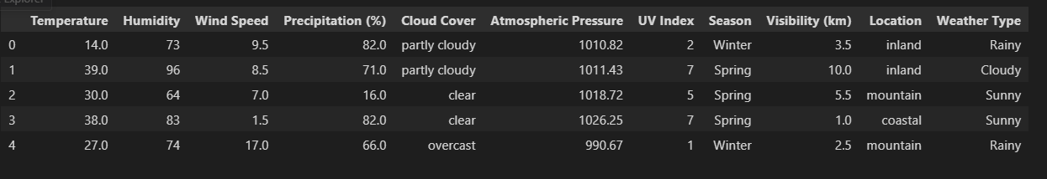
1. Data Description
Our Project is contains Two Datasets:
A Dataset is for classification tasks
A Dataset is for regression and forecasting tasks

Slide 5
1. Data Description
Temperature: Measure of warmth or coldness in °C.
Humidity: Amount of water vapor in the air, in %.
Wind Speed: Air movement rate in km/h.
Precipitation (%): Probability of precipitation, in %.
Cloud Cover: Sky fraction covered by clouds.
Atmospheric Pressure: Weight of the atmosphere in hPa.
UV Index: Strength of UV radiation on a scale from 0 to 11+.
Season: Time of the year (Winter, Spring, Summer, Autumn).
Visibility (km): Distance one can see clearly in km.
Location: Geographical setting (inland, mountain, coastal).
Weather Type: Overall weather condition (Rainy, Cloudy, Sunny, Snowy).

Slide 6
2. Exploratory Data Analysis (EDA)
From the EDA we done we can exclude that: the rainy weather temperature ranges from -19.0 to 70.0
the sunny weather temperature ranges from -16.0 to 71.0
the snowy weather temperature ranges from -24.0 to 49.0
the cloudy weather temperature ranges from -18.0 to 71.0 the rainy weather humidity ranges from 21 to 109
the sunny weather humidity ranges from 20 to 109
the snowy weather humidity ranges from 20 to 109
the cloudy weather humidity ranges from 20 to 109 the rainy weather wind speed ranges from 0.0 to 26.0
the sunny weather wind speed ranges from 0.0 to 24.5
the snowy weather wind speed ranges from 0.0 to 26.0
the cloudy weather wind speed ranges from 0.0 to 26.0

Slide 7
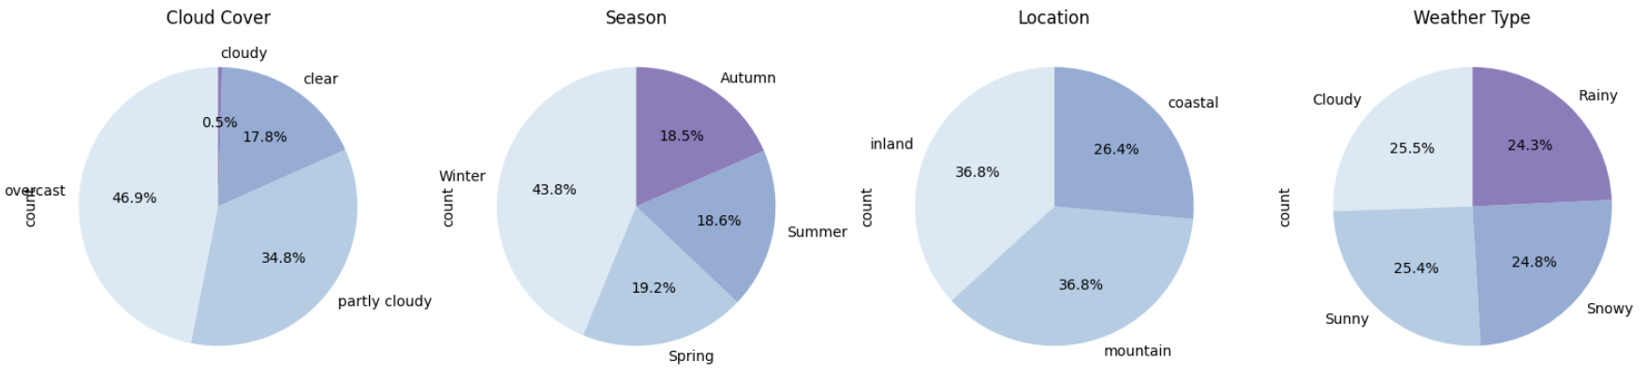
2. Exploratory Data Analysis (EDA)
To learn more about the dataset, we can visualize the distribution of each category's features using this plot.

Slide 8
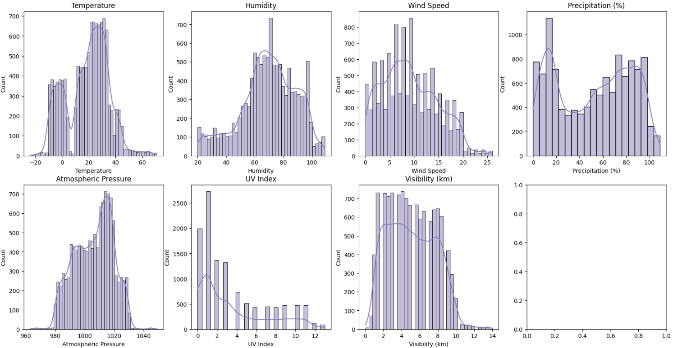
2. Exploratory Data Analysis (EDA)
To learn more about the data distribution for the numerical features we can see this plot. From this plot, we can conclude that there is a skewed data that can corrupt our ML model so we should handle it

Slide 9
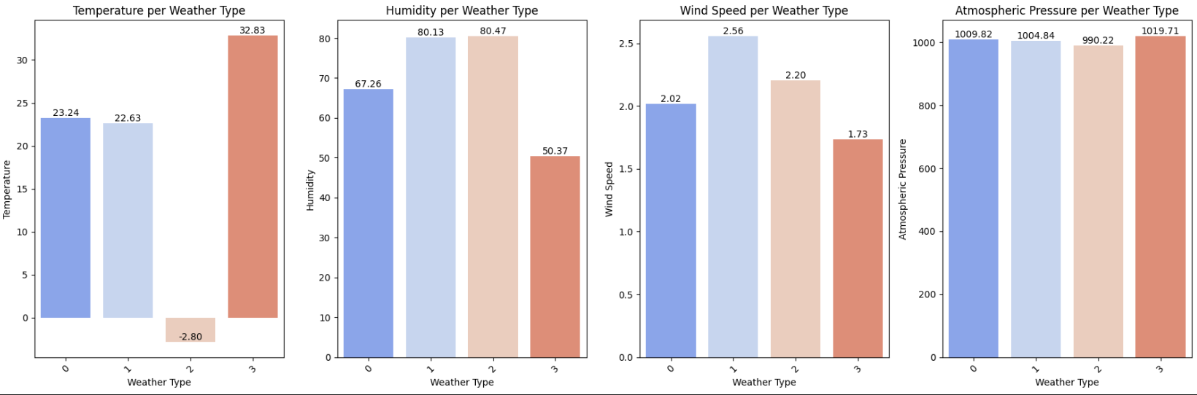
2. Exploratory Data Analysis (EDA)
To learn more about the average Temperature, Humidity, Wind speed, and pressure in each weather type we can see this plot. 0 → Cloudy, 1→ rainy, 2→Snowy, 3→ sunny

Slide 10
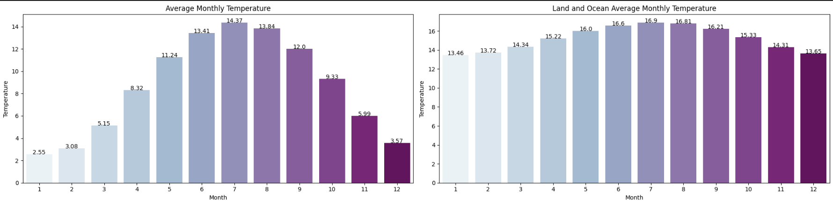
2. Exploratory Data Analysis (EDA)
To get the average monthly temperature from 1750 - 2015

Slide 11
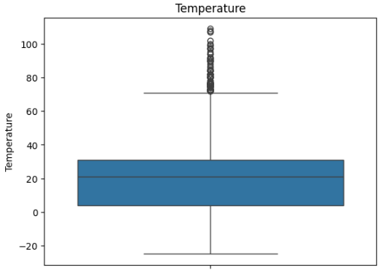
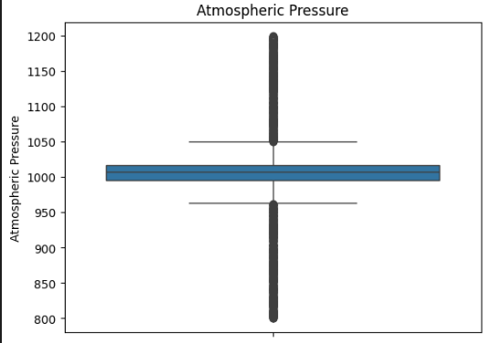
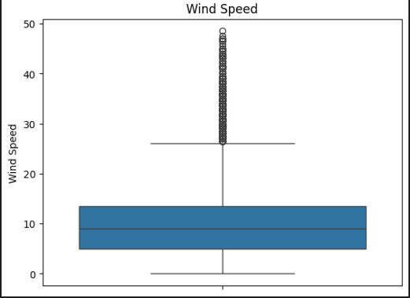
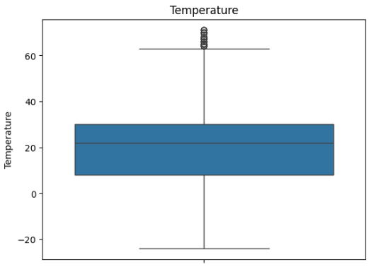
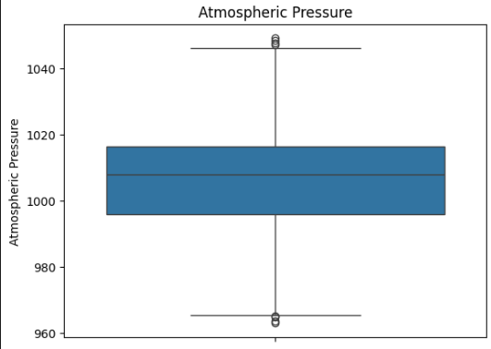
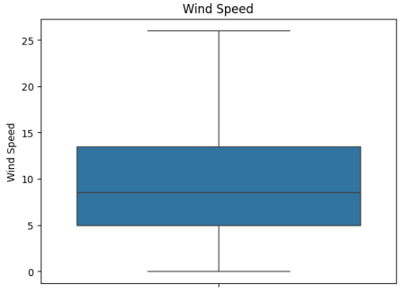
3. Outlier handling
1.What is IQR Method:
We used The Interquartile Range (IQR) method which is used to detect outliers in a dataset. It is calculated as the difference between the third quartile (Q3) and the first quartile (Q1). The IQR equation is: IQR=𝑄3−𝑄1, IQR=Q3−Q1 Outliers are typically defined as data points below “𝑄1 − 1.5 × IQR” or above “𝑄3+1.5×IQR”.

Slide 12
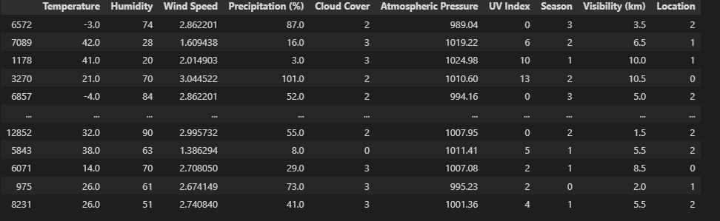
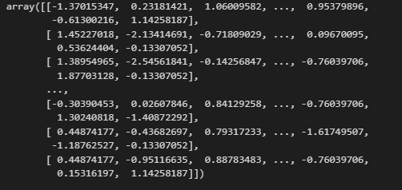
4. Data Preprocessing
1. Encoding using LabelEncoder:
We use label encoding to encode the categories columns into a labeled numeric columns. Ex: 0→ cloudy, 1→sunny, 2→windy, 3→rainy
2. Feature Scaling / Normalization:
Feature scaling is performed to standardize the range of independent variables, ensuring each feature contributes equally to model training.It improves model convergence speed and performance by preventing features with larger scales from dominating Common methods include normalization (min-max scaling) and standardization (z-score scaling)

Slide 13
4. Data Preprocessing
3. Drop unneeded Columns
We drop the unneeded columns from the second dataset
Ex: drop “LandAverageTemperatureUncertainty” and “LandMaxTemperatureUncertainty”
2. Columns Renaming:
Tried to rename features to make it more easier to read

Slide 14
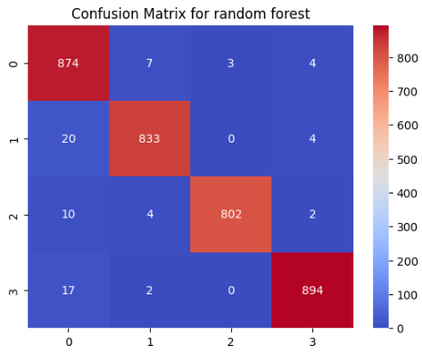
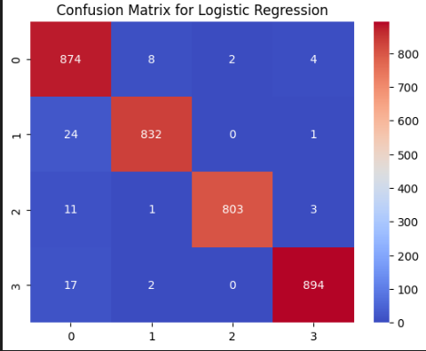
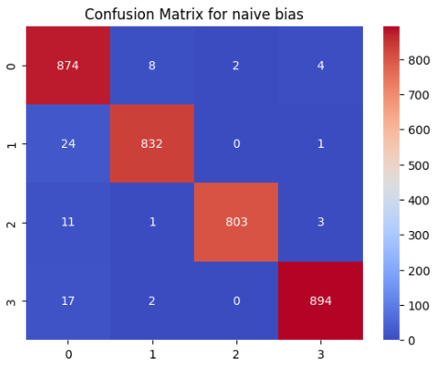
5. Model Selection for Classification Tasks
We use a lot of Machine learning models to help us classify the
weather category:
LogisticRegression
naive_bayes
RandomForestClassifier
And for each model we create a confusion matrix to classify
what is the right prediction and wrong ones:

Slide 15
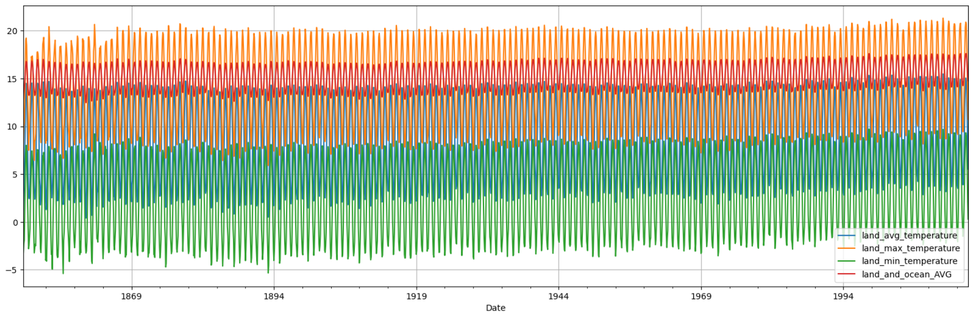
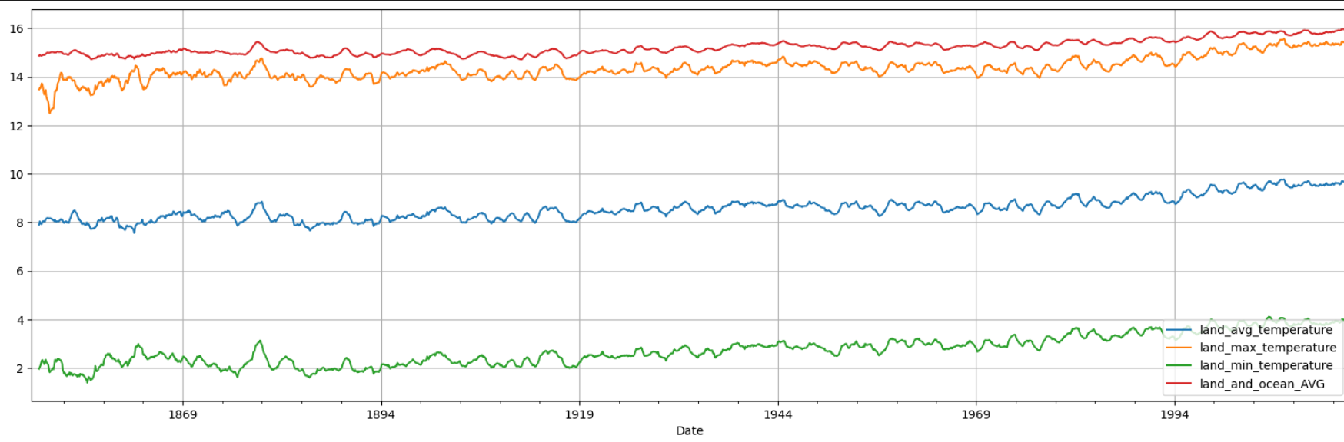
6.Time Series Analysis
Date Column reindexing:
Make the date column as the index column for the dataset
Plot the time series plot with and without rolling average:
Get the time series plot over a time from 1750 – 2015

Slide 16
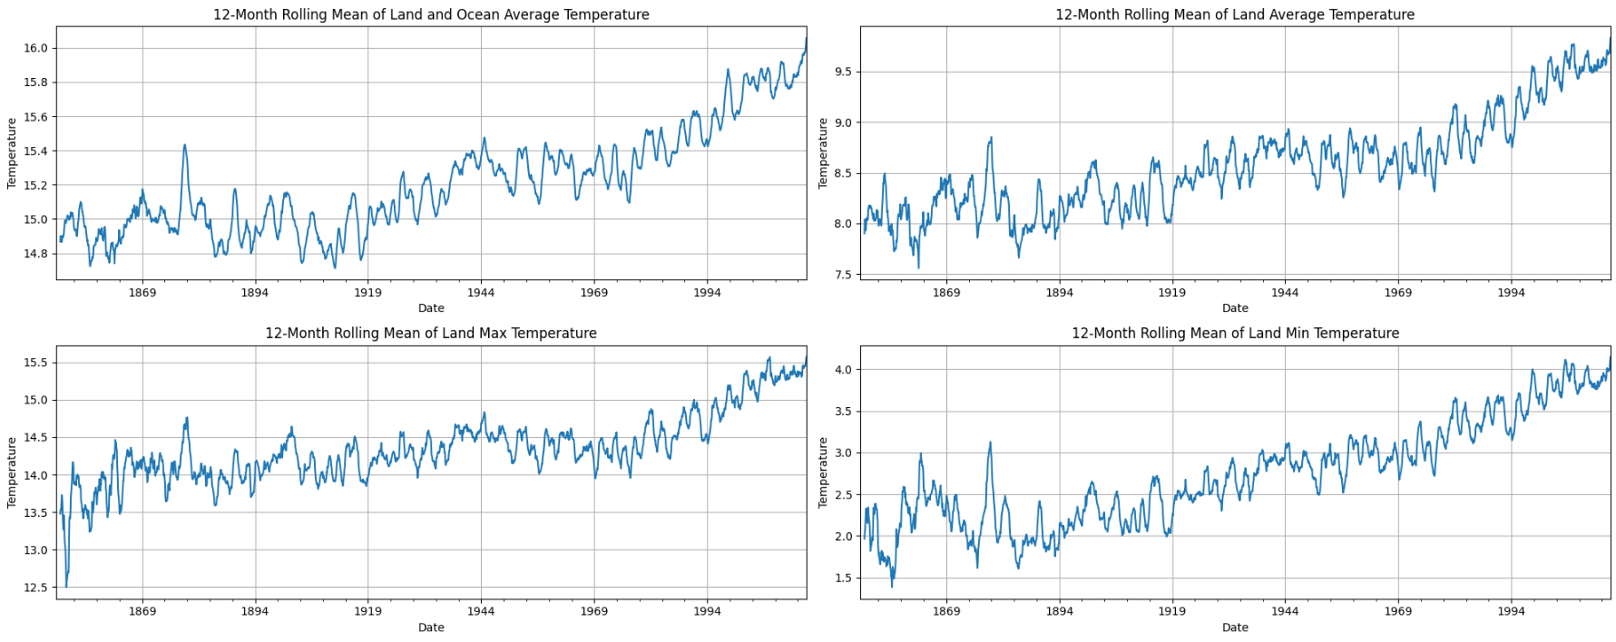
6.Time Series Analysis
Date Column reindexing:
Get the monthly rolling average of each feature in the second dataset

Slide 17
8. Model Selection for Regression Task
Regression Model Selection:
We use many Machine learning models to help us to predict the
weather degree using the first dataset but the highest ML model is the random forest regressor
Model Evaluation:
We get the MSE to evaluate our trained model and the model gets this error. Train Error: 0.004
Test Error: 0.031

Slide 18
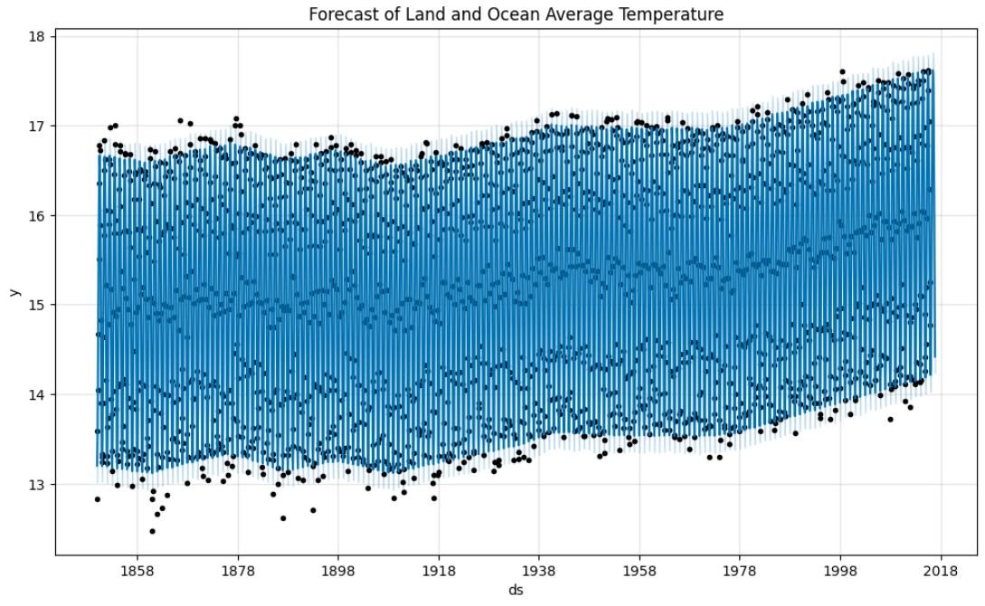
7. Predict Temperature for a Specific Date using forecasting
Initialize and Fit the Model:
initialize the Prophet model and fit it using the prepared DataFrame. This step involves training the model to understand the historical data and capture the seasonality and trends. And plotting the Forecast of Land and Ocean Average Temperature

Slide 19
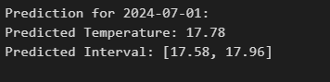
8. Predict Temperature for a Specific Date using forecasting
Model Validation using examples:
Define a function predict_temperature that takes a date string as input, converts it to a DateTime object, and creates a DataFrame for that date.
Use the trained model to predict the temperature for the specified future date, returning the predicted value along with the confidence intervals

Slide 20
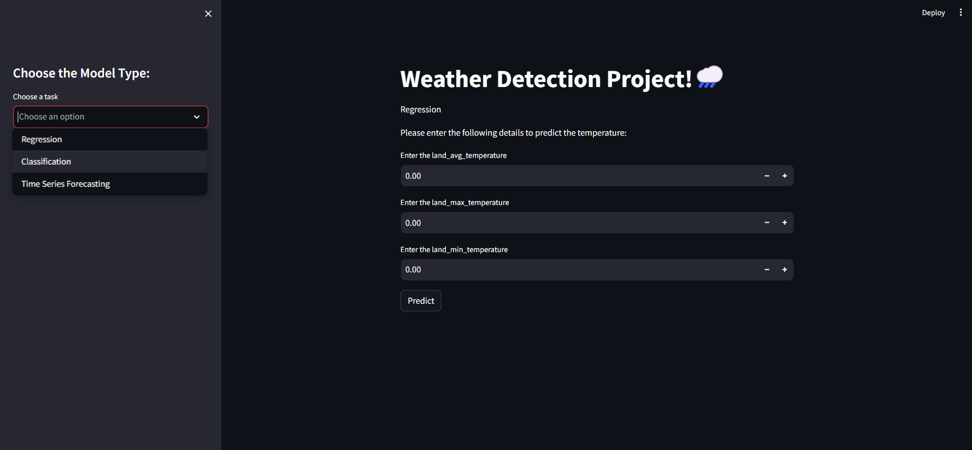
9. Web Application Deployment
Streamlit web application
In this project, we utilize Streamlit as our deployment tool to transform our AI model into an interactive dashboard. This platform enables users to input text, triggering our AI models and algorithms, to provide an prediction for the weather tempreture

Slide 21
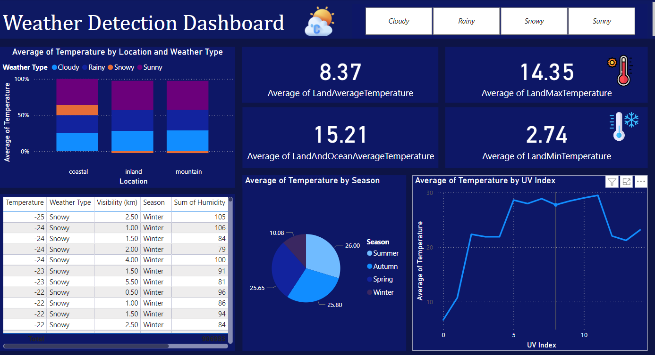
9. Web Application Deployment
Dashboard using Power BI:

Slide 22
Thanks! Machine Learning Project

